Slide 1

Database design and Applications IS ZC337 Prof Uma Maheswari

Slide 2
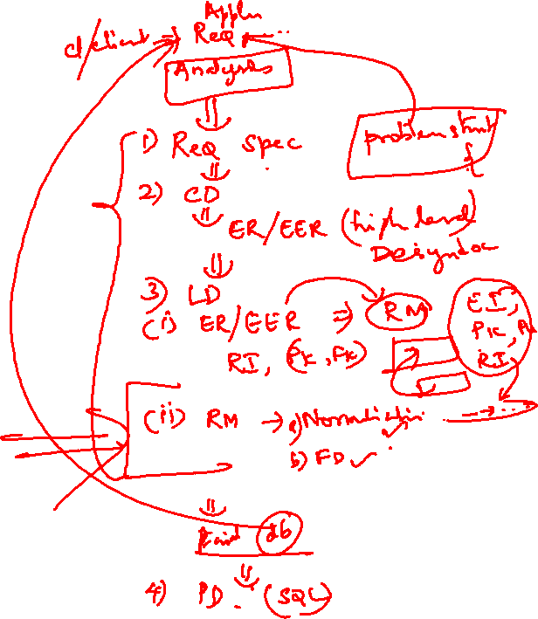
Session 6:
Topic : Logical design II
(FD and Normalization)

Slide 3

LEARNING OUTCOME
FDs
Normalization
REFER: T1-Chapter 5
Sections:
5.1- 5.3

Slide 4
FUNCTIONAL DEPENDENCIES

Slide 5
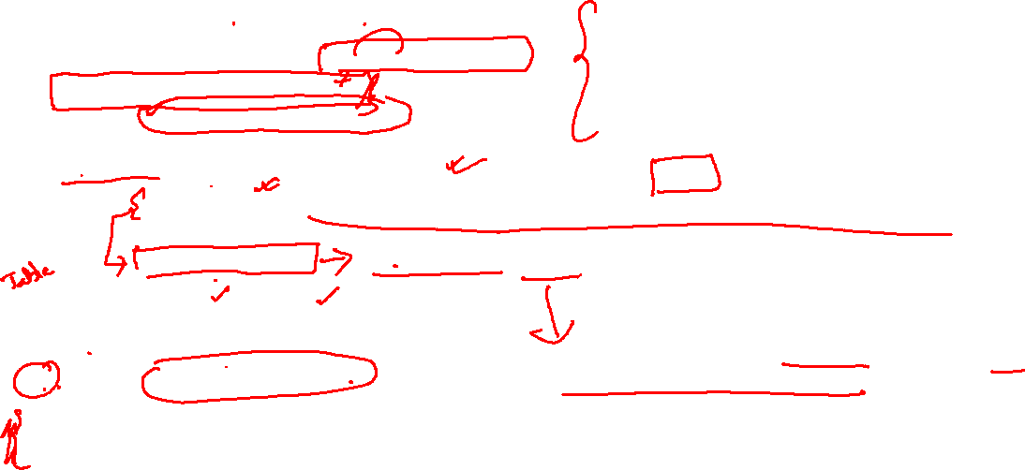
FD
What is a functional dependency?
Functional Dependency is when one attribute determines another attribute in a DBMS system. Functional Dependency plays a vital role to find the difference between good and bad database design.
Example:
By this, we can say that Employee Name, and salary are functionally depended on Employee number.
A functional dependency is denoted by an arrow →
The functional dependency of X on Y is represented
by X →Y
if we know the value of Employee number, we can obtain Employee Name and Salary
Written as :
Employee number --→ Employee Name , Salary.
Employee number | Employee Name | Salary
1 | Dana | 50000
2 | Francis | 38000
3 | Andrew | 25000
A Functional dependency is a constraint between two sets of attributes in a relation from a database.

Slide 6
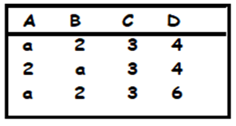
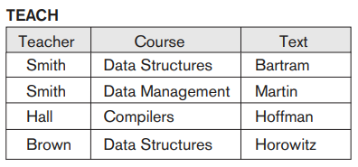
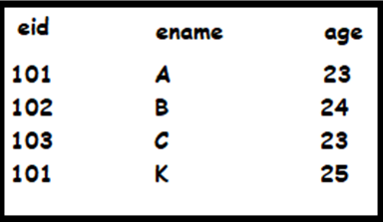
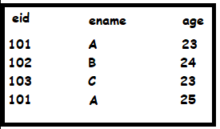
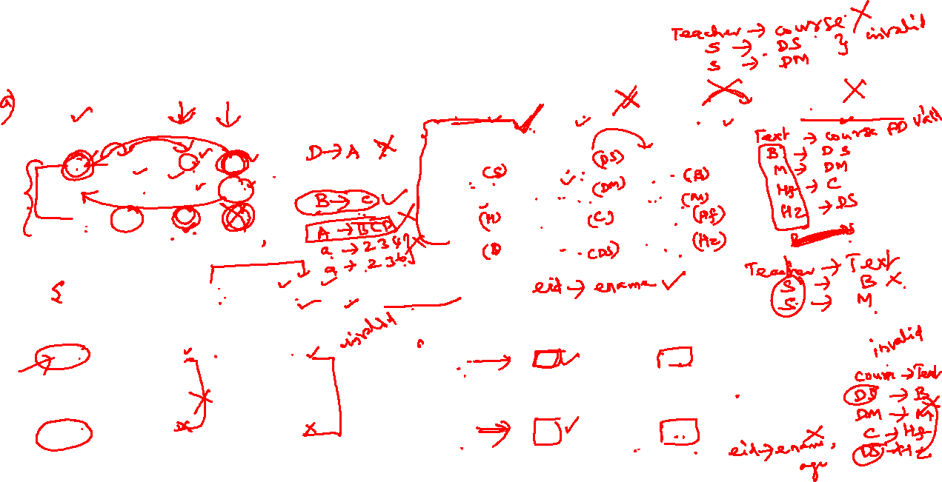
Functional Dependencies : Exercise
Determine the FDs for the following schema?
Which is valid FD ?
TEXT → COURSE, TEACHER → COURSE, TEACHER --> TEXT, COURSE → TEXT
A relation state of TEACH with a possible functional dependency TEXT → COURSE. However,
TEACHER → COURSE, TEACHER → TEXT and COURSE → TEXT are ruled out.
Determine if FD: eid → {ename, age} valid or not?
Determine if FD:
eid → ename
valid or not?

Slide 7
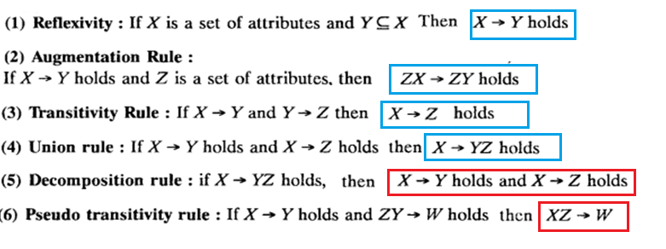
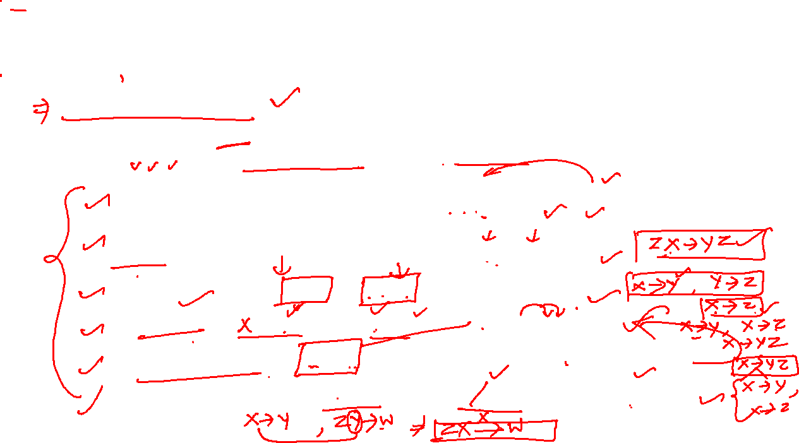
Functional Dependencies

Slide 8

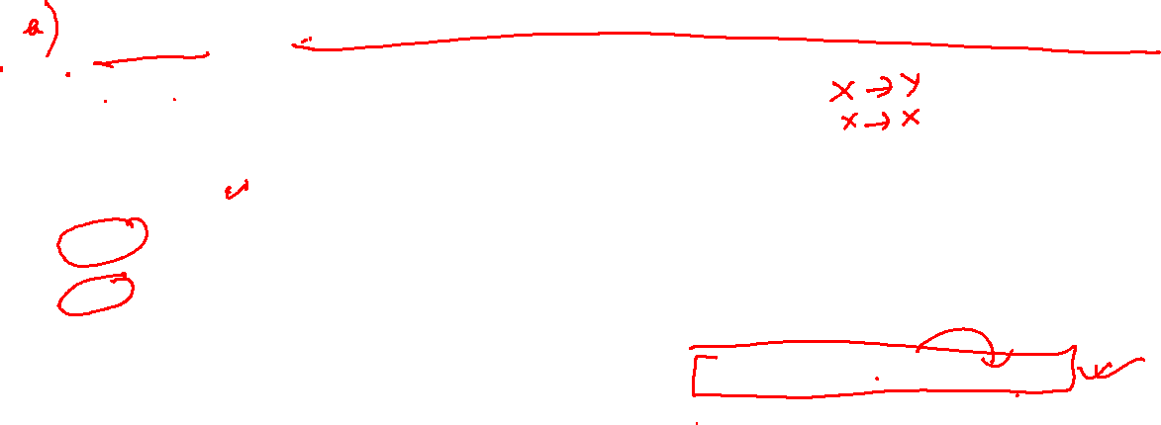
Types of Functional Dependencies
Trivial dependency is a set of attributes which are called a trivial if the set of attributes are included in that attribute.
So, X -> Y is a trivial functional dependency if
ie., {X,Y} ->X
The following dependencies are also trivial: X->X & Y->Y.
Consider this table with two columns Emp_id and Emp_name.
X is superkey and is {Emp_id, Emp_name}
So {Emp_id, Emp_name} -> Emp_id
is a trivial functional dependency as Emp_id is a subset of {Emp_id,Emp_name}.
Emp_id | Emp_name
AS555 | Harry
AS811 | George
AS999 | Kevin

Slide 9


Types of Functional Dependencies
Non-trivial functional dependency
Functional dependency which also known as a nontrivial dependency occurs when X->Y
holds true where Y is not a subset of X. In a relationship, if then it is considered as
a non-trivial dependency.
Example:
{Company} -> {CEO} (if we know the Company, we know the CEO name)
X= Company which is CK and Y is CEO , but
Since CEO is not a subset of Company, and hence it's non-trivial functional dependency.
Company | CEO | Age
Microsoft | Satya Nadella | 51
Google | Sundar Pichai | 46
Apple | Tim Cook | 57

Slide 10
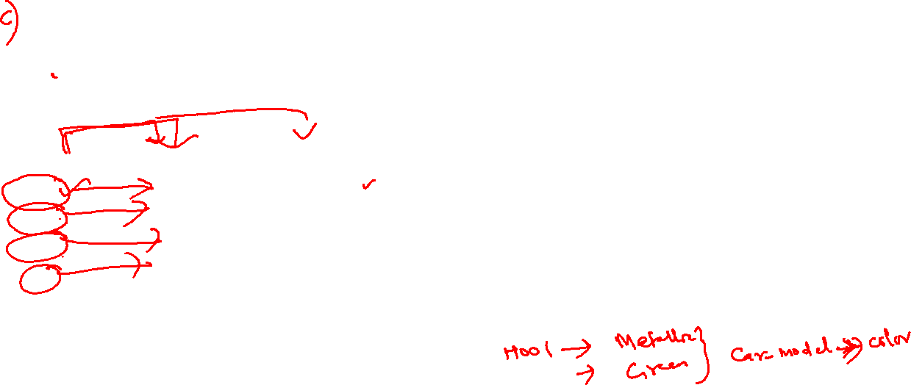
Types of Functional Dependencies
Multivalued dependency occurs in the situation where there are multiple independent multivalued attributes in a single table.
A multivalued dependency is a complete constraint between two sets of attributes in a relation. It requires that certain tuples be present in a relation.
Car_model | Maf_year | Color
H001 | 2017 | Metallic
H001 | 2017 | Green
H005 | 2018 | Metallic
H005 | 2018 | Blue
H010 | 2015 | Metallic
H033 | 2012 | Gray
Maf_year and color are independent of each other but dependent on car_model.
In this example, these two columns are said to be multivalue dependent on car_model.
This dependence can be represented like this:
car_model maf_year and car_model colour

Slide 11

Types of Functional Dependencies
A transitive dependency is a type of functional dependency which happens when t is indirectly formed by two functional dependencies.
{Company} -> {CEO} (if we know the company, we know its CEO's name)
{CEO } -> {Age} If we know the CEO, we know the Age.
Represented as {Company} -> {CEO} and {CEO}->{Age}
Therefore according to the rule of rule of transitive dependency:
{ Company} -> {Age} should hold, that makes sense because if we know the company name, we can know his age.
Note: You need to remember that transitive dependency can only occur in a relation of three or more attributes.
Company | CEO | Age
Microsoft | Satya Nadella | 51
Google | Sundar Pichai | 46
Alibaba | Jack Ma | 54

Slide 12

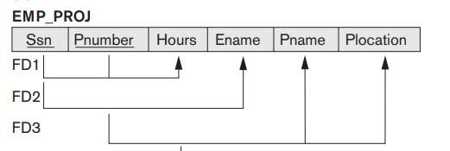
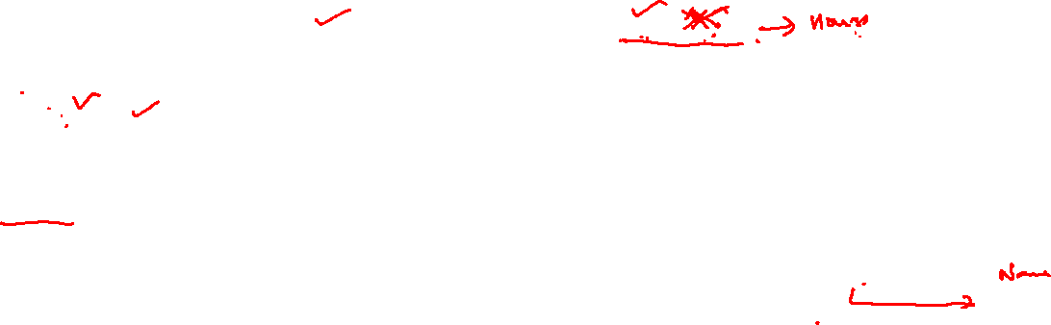
Types of Functional Dependencies
Full Functional Dependency:
A FD X → Y is a full functional dependency if removal of any attribute A from X means that the dependency does not hold any more.
X is superkey ie., {SSN,Pnumber}
If we remove SSN from X then Pnumber → Hours is not VALID!
IIly If we remove Pnumber from X then SSN → Hours is also not VALID!
This is called FULL FD.
Partial FD : A functional dependency X → Y is a partial dependency if some attribute A ε X can be removed from X and the dependency still holds; that is, for some A ε X, (X − {A}) → Y.
X is superkey ie., {SSN,Pnumber}
Y is Ename
If we remove SSN from X and
Now FD2 is SSN → Ename holds true .
This is called Partially FD.
IIly FD3 Pnumber → Pname. Plocation is also Partial FD

Slide 13
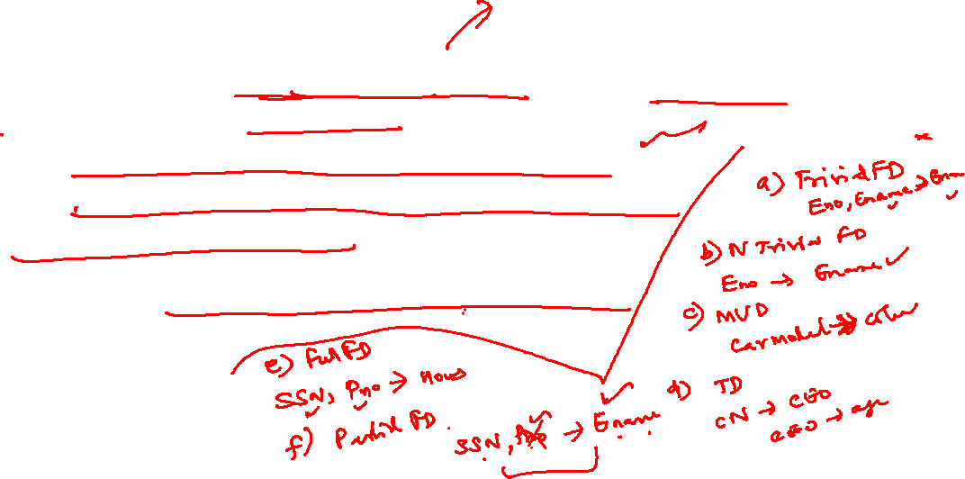
FD
Advantages of Functional Dependency
Functional Dependency avoids data redundancy. Therefore same data do not repeat at multiple locations in that database
It helps you to maintain the quality of data in the database
It helps you to defined meanings and constraints of databases
It helps you to identify bad designs
It helps you to find the facts regarding the database design

Slide 14
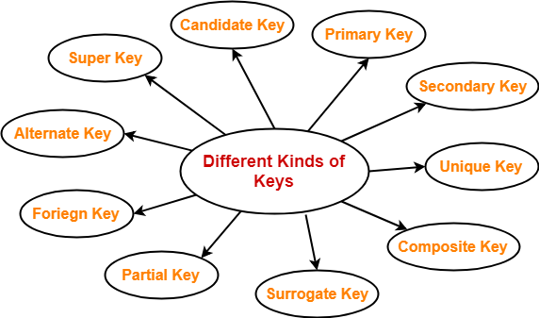
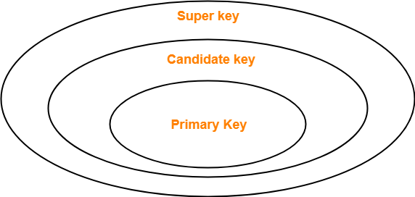
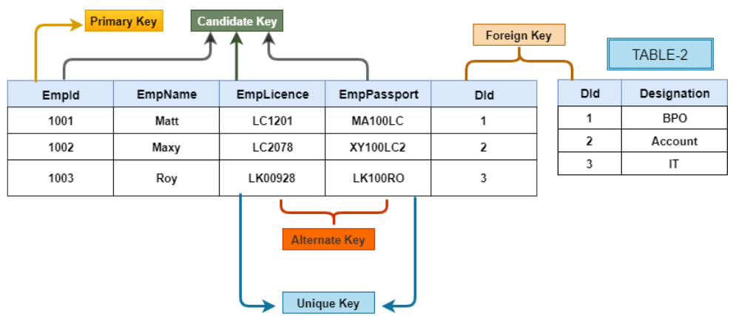
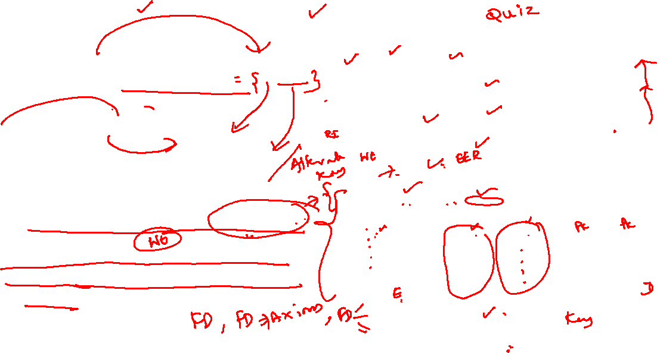
Key Attributes and its types:
If a relation schema has more than one key, each is called a candidate key.
One of the candidate keys is arbitrarily designated to be the primary key,
and the others are called secondary keys.
In a practical relational database, each relation schema must have a primary key.
If no candidate key is known for a relation, the entire relation can be treated as a default superkey.

Slide 15
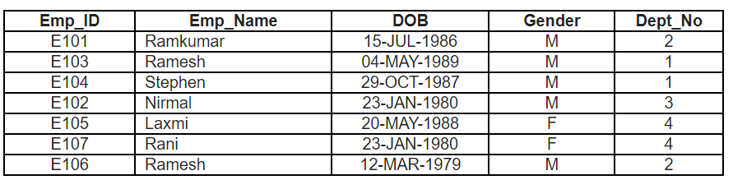
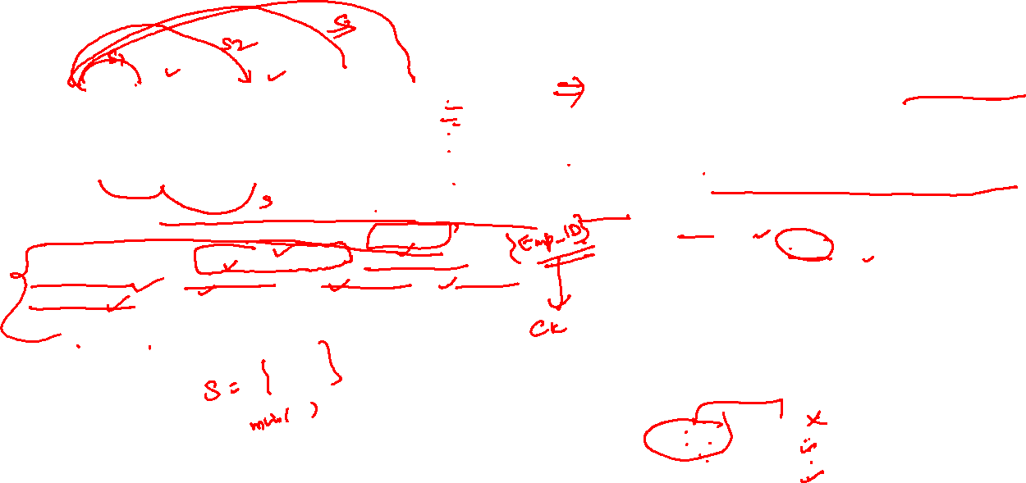
Super Key:
For any table, we have at least one super key which is the combination of all the attributes of the table. This is trivial superkey.
In RDBMS, no two records are allowed to be the same. For example, at least the complete single record (E101, Ramkumar, 15-JUL-1986, M, 2) is different from (E105, Laxmi, 20-MAY-1988, F, 4). Hence, we have at least one super key.
Note: Redundant attributes are permitted in Super Keys.
E.g.,
In (Emp_ID, Emp_Name), Emp_Name is unnecessary and redundant.
Superkey : Set of one or more attributes together can uniquely identify rest of the attributes of a relation uniquely is called Superkey.
any of the combinations, (Emp_ID, Emp_Name), (Emp_ID, DOB), (Emp_ID, Gender), (Emp_ID, Dept_No), (Emp_Name, DOB), (Emp_Name, DOB, Gender), and so on [you form the other combinations which can uniquely identify records] can also identify the records uniquely.

Slide 16

Candidate Key:
For our table Employee’s instance (information stored at a particular moment in a table is called instance), we have the following candidate keys (please check them);
(Emp_ID)
(Emp_Name, DOB)
(Emp_Name, Dept_No)
(DOB, Dept_No)
(DOB, Gender)
All the listed candidate keys are minimal. If you divide them further, they lose the property of a key. That is, for example, Dept_No alone cannot uniquely identify.
Candidate Key
Minimal Super key is a key which is a super key without any redundant attribute (unnecessary combination). In other words, if you remove any attribute from a key combination, it should not be able to uniquely identify data.
For example, (Emp_ID, Emp_Name) is a super key with an unnecessary attribute Emp_Name.
Here, without Emp_Name attribute, only Emp_ID attribute can uniquely identify records. Hence, Emp_ID is itself a minimal super key.
For example, {(Emp_ID), (Emp_Name)} is proper subset of set (Emp_ID, Emp_Name). In this, (Emp_ID) is itself a super key. Hence, (Emp_ID, Emp_Name) is not a candidate key but a super key.
As another example, (Emp_Name, DOB) is a super key and it is minimal. That is, the proper subset {(Emp_Name), (DOB)} does not contain any super keys. So, (Emp_Name, DOB) is a candidate key.

Slide 17
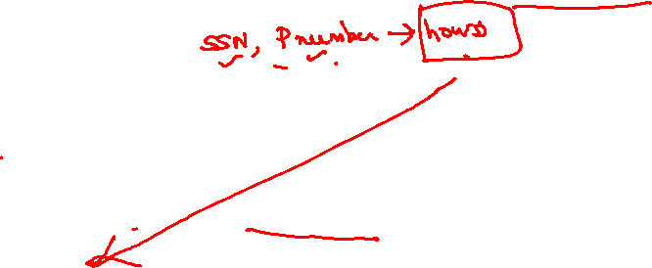
Prime and Non Prime attributes
Prime Attributes or PA :
An attribute of relation schema R is called a prime attribute of R if it is a member of some candidate key of R.
For Ex. : Work-on
Both SSN and PNUMBER are prime attributes of work-on
Non Prime Attribute or NPA :
An attribute of relation schema R is called non prime attribute if it is not a member of any candidate key.
e.g., Hours is non prime attribute of work-on.

Slide 18
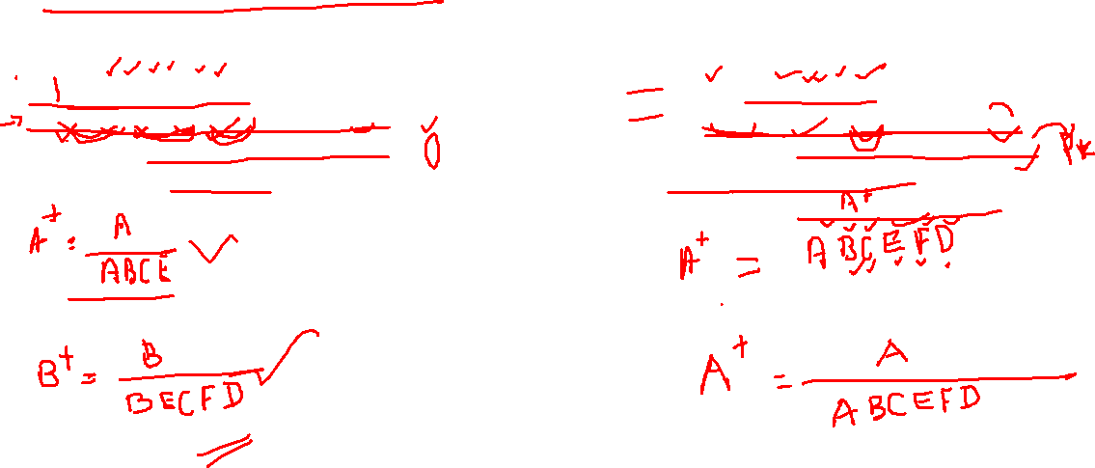
Closure of Attributes using the FDs:
Let R = {A, B, C, D, E, F} and a set of FDs
F={ A ->BC, E-> CF, B ->E, CD ->EF, F->D}
Compute the closure of a set of attribute {A, B}
under the given set of FDs.
Let R = {A, B, C, D, E, F} and a set of FDs
F ={A ->BC, E-> CF, B ->E, CD ->EF, F->D}
Compute the closure of an attribute {A}
under the given set of FDs.

Slide 19
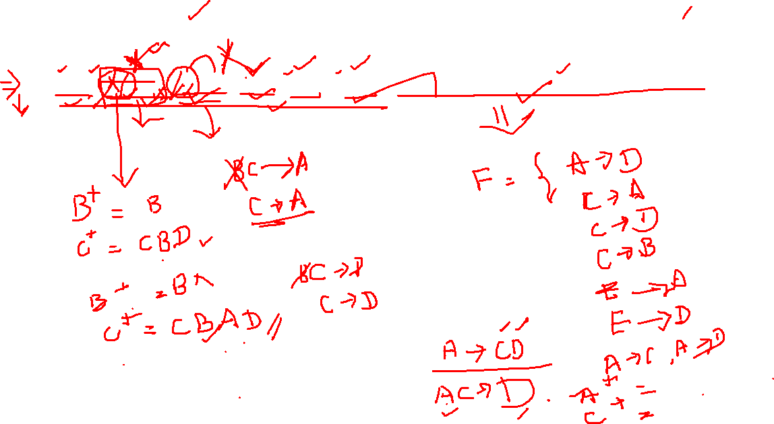
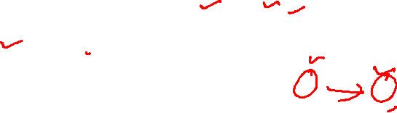
Attribute closure and Extraneous Attributes :
F= {A->D, BC->A, BC->D, C->B,E->A, E->D} Determine extraneous attributes?

Slide 20
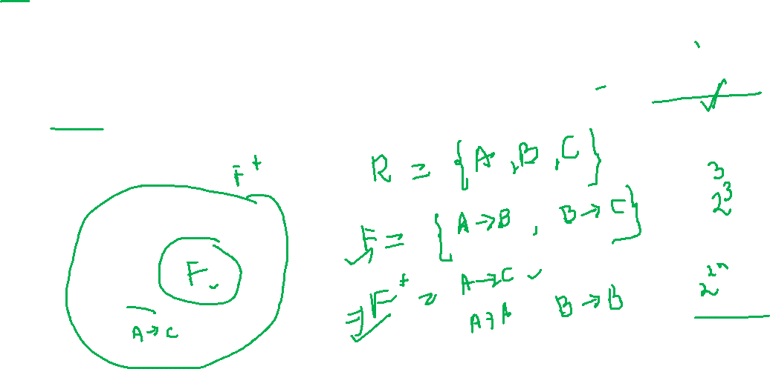
Closure of FD set or F⁺:
The set of functional dependencies that is logically implied by F is called the closure of F and is written as F⁺

Slide 21
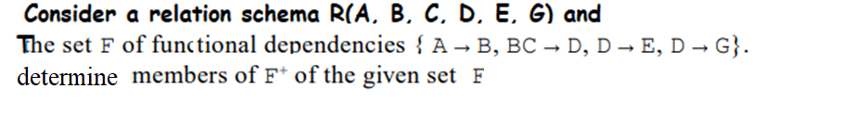
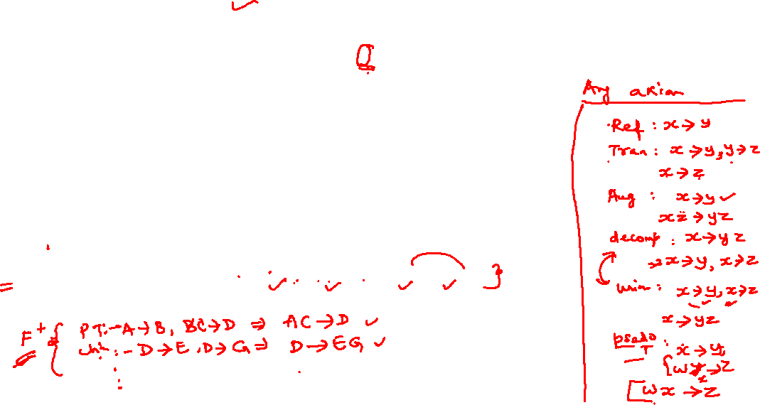
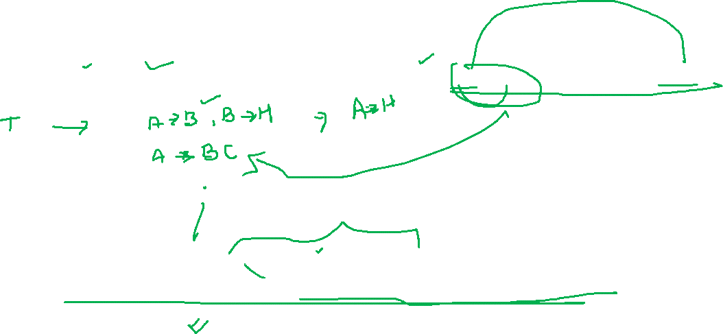
Problems using Armstrong’s axiom:
1.
2.

Slide 22
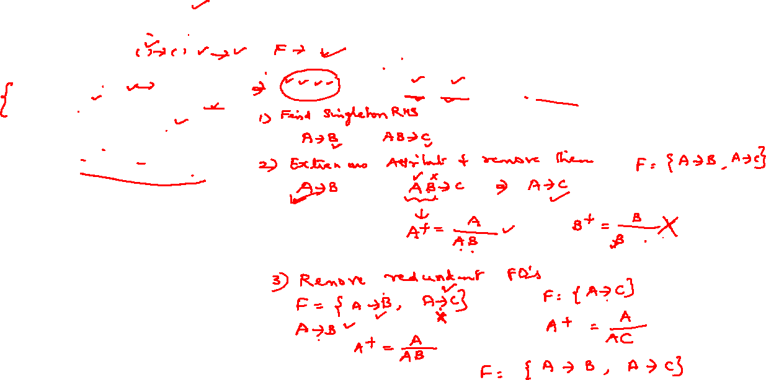
Canonical cover or minimal set of FDs:
Singleton RHS
2. Extraneous attributes removed
3. Remove redundant FDs.
R(A ,B ,C) and F = {A->B ,AB->C }. Find minimal cover?
A canonical cover is "allowed" to have more than one attribute on the RHS.
A minimal cover cannot.
As an example, the canonical cover may be "A -> BC" where the minimal cover would be "A -> B, A -> C".

Slide 23
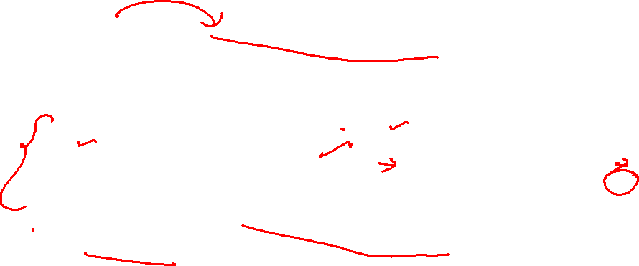
Canonical cover or minimal set of FDs:
A minimal cover of a set of functional dependencies E is a set of functional dependencies F that satisfies the property that every dependency in E is in the closure F+ of F.
A set of functional dependencies F to be minimal if it satisfies the following condition.
Every dependency in F has a single attribute for its right-hand side.
We cannot replace any dependency X -+ A in F with a dependency Y -+ A, where Y is a proper subset of X and still have a set of dependencies that is equivalent to F.
We cannot remove any dependency from F and still have a set of dependencies that is equivalent to F.

Slide 24
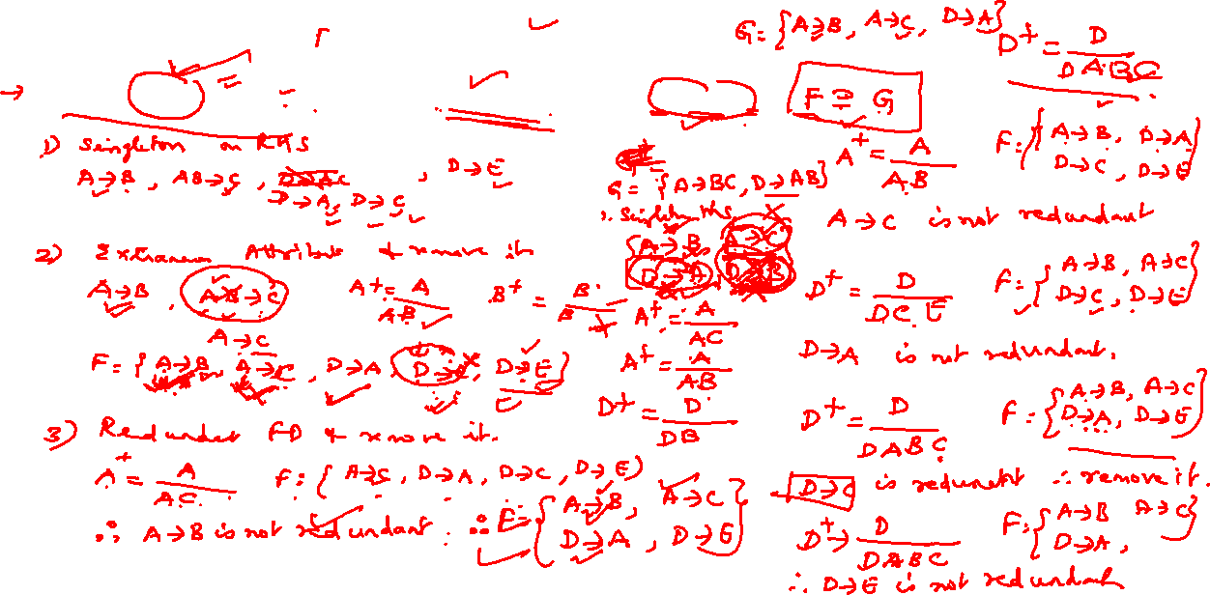
Canonical cover or minimal cover:
F = {A ->B, AB->C, D->AC, D->E} and G = {A->BC, D->AB}. Find if F covers G?

Slide 25
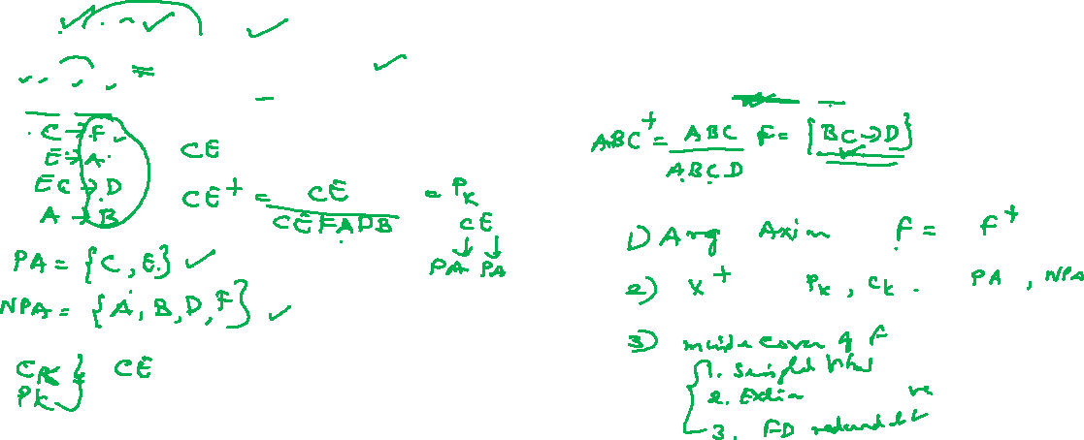
Problem
Find Ckey/Prime Key/minimal key and NPA?
R(A,B,C,D,E,F)
F={C->F,E->A, EC->D, A->B}
Find non redundant FD:
R(A,B,C,D) F={ABC->D, BC->D}

Slide 26
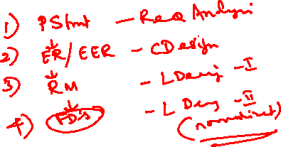
Logical Design - Normalization

Slide 27
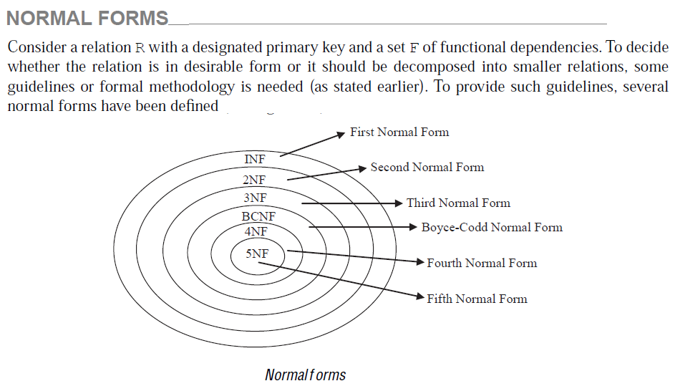
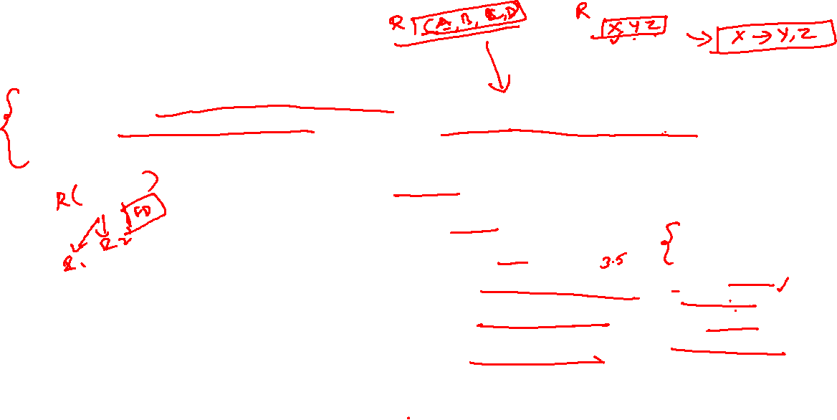
Normalization
Note:
Decomposing relations should
Should preserve DEPENDENCY.
(ie., FDs of the original relation are not lost. )

Slide 28
1 NF

Slide 29
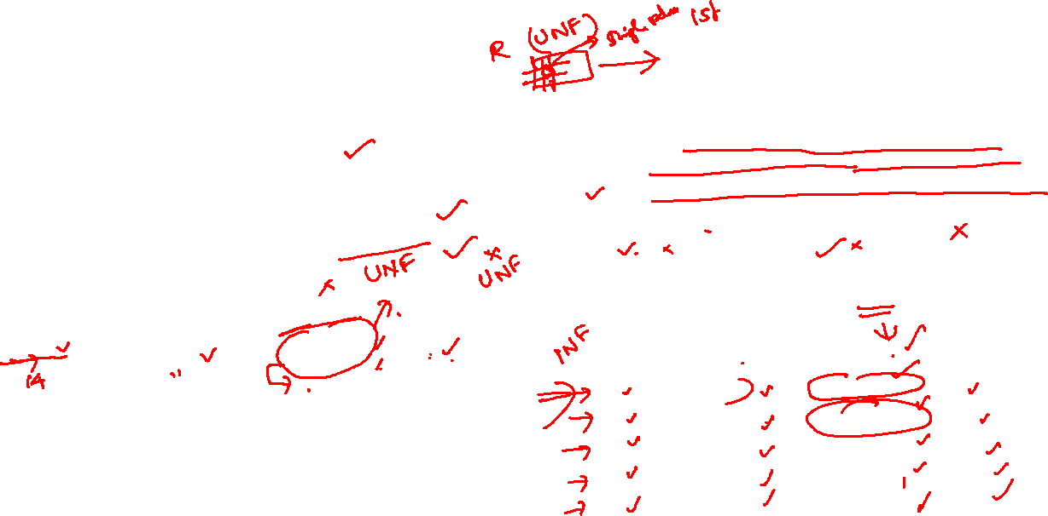
Normalization: 1NF
A relation will be 1NF
If it contains an atomic value.
It states that an attribute of a table cannot hold multiple values.
It must hold only single-valued attribute.
First normal form disallows the multi-valued attribute, composite attribute, and their combinations.
1NF disallows relations within relations or relations as attribute values within tuples. The only attribute values permitted by 1NF are single atomic (or indivisible) values.
EMPLOYEE table
SOLUTION:
The EMPLOYEE table into 1NF has been shown below:
EMP_ID | EMP_NAME | EMP_PHONE | EMP_STATE
14 | John | 7272826385, 9064738238 | UP
20 | Harry | 8574783832 | Bihar
12 | Sam | 7390372389, 8589830302 | Punjab
EMP_ID | EMP_NAME | EMP_PHONE | EMP_STATE
14 | John | 7272826385 | UP
14 | John | 9064738238 | UP
20 | Harry | 8574783832 | Bihar
12 | Sam | 7390372389 | Punjab
12 | Sam | 8589830302 | Punjab
Relation EMPLOYEE is not in 1NF because of multi-valued attribute EMP_PHONE.

Slide 30
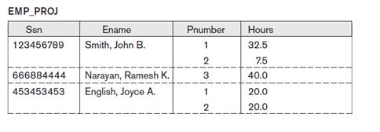
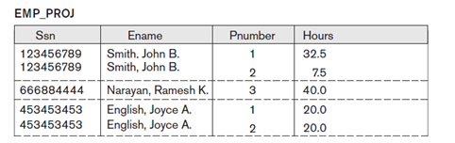
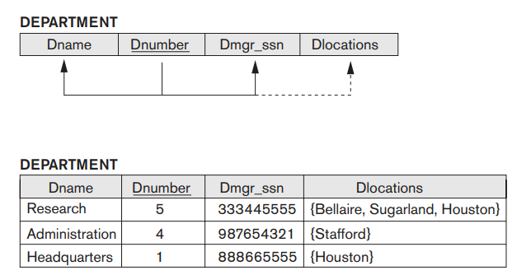
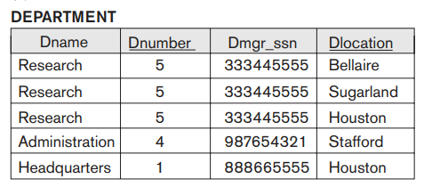
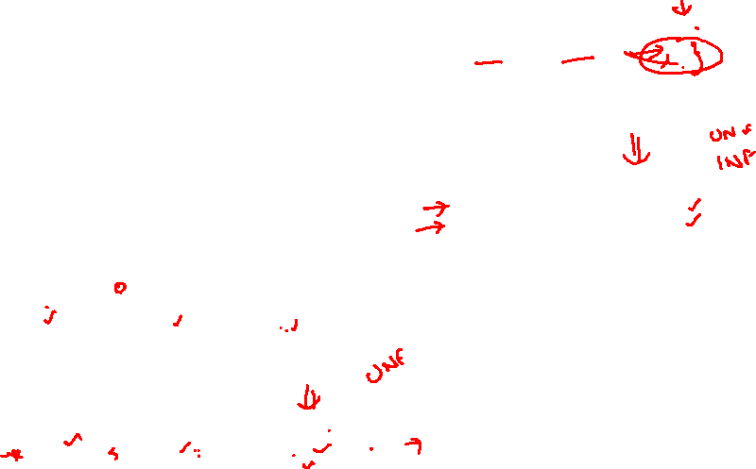
Normalization : 1NF
1NF (tables values are single and atomic)
Check if table is in UnNormalized Form UNF (ie., tables values are not single and atomic)
Yes: Relation should have no multivalued attributes or nested relations.
So make all values as single and atomic.
Remedy : Form new relations for each multivalued attribute or nested relation.

Slide 31
2 NF

Slide 32
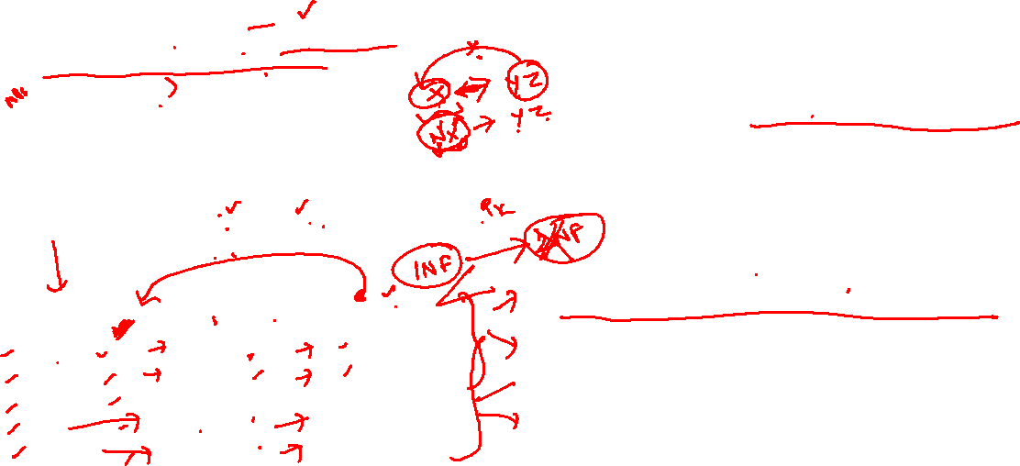
Normalization: 2 NF
In the 2NF,
Relational must be in 1NF.
All non-key attributes are fully functional dependent on the primary key ie., no partial dependency.
Is the Table in 2NF?
In the given table, non-prime attribute TEACHER_AGE is dependent on TEACHER_ID which is a proper subset of a candidate key.
That's why it violates the rule for 2NF.
Example: Let's assume, a school can store the data of teachers and the subjects they teach. In a school, a teacher can teach more than one subject.
To convert the given table into 2NF, we decompose it into two tables:
Candidate Keys/PK: {Teacher_Id, Subject} Non prime attribute: Teacher_Age
TEACHER table
2NF requires that all data elements in a table are full functionally dependent on the table's primary key.
• If data clement only dependent on part of primary key ie., partial dependent, then they are parsed out to separate tables.
TEACHER_ID | SUBJECT | TEACHER_AGE
25 | Chemistry | 30
25 | Biology | 30
47 | English | 35
83 | Math | 38
83 | Computer | 38

Slide 33
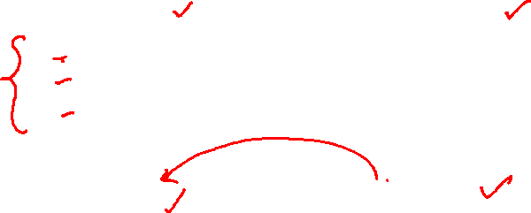
Normalization : 2 NF
TEACHER_DETAIL table:
TEACHER_ID | TEACHER_AGE
25 | 30
47 | 35
83 | 38
TEACHER_SUBJECT table:
TEACHER_ID | SUBJECT
25 | Chemistry
25 | Biology
47 | English
83 | Math
83 | Computer

Slide 34
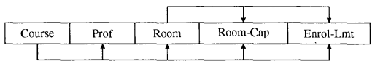
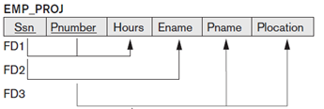

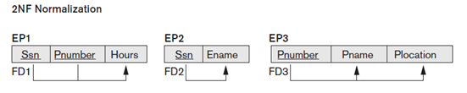
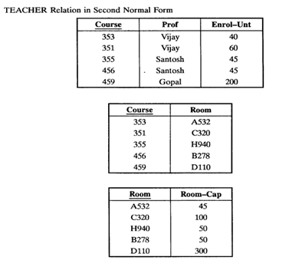
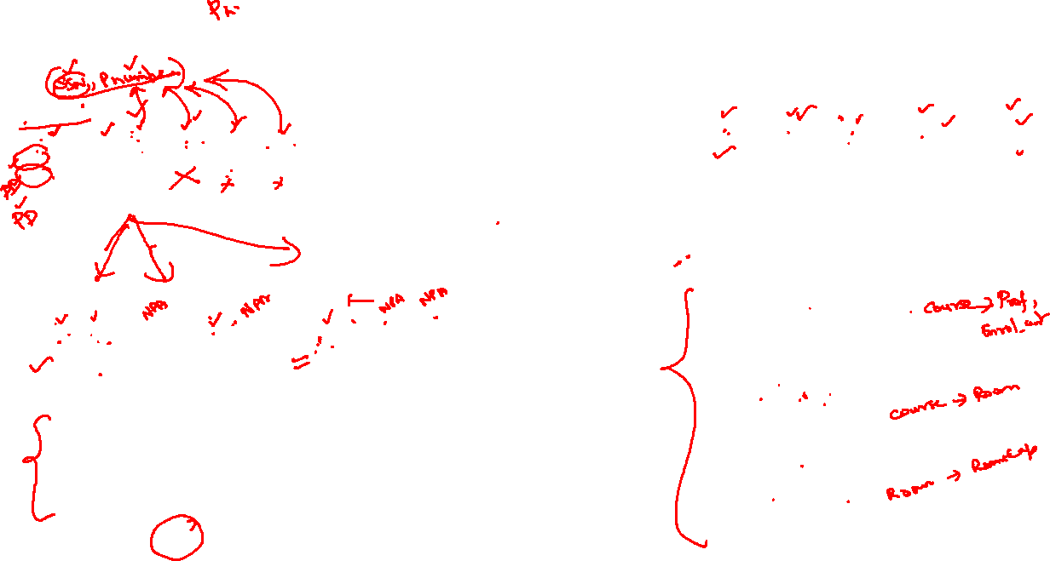
Normalization : 2 NF
FD 1: SSN, Pnumber -> hours
FD 2: SSN → ename
FD 3: Pnumber → Pname, Plocation
Now table in 2NF

Slide 35
3 NF

Slide 36
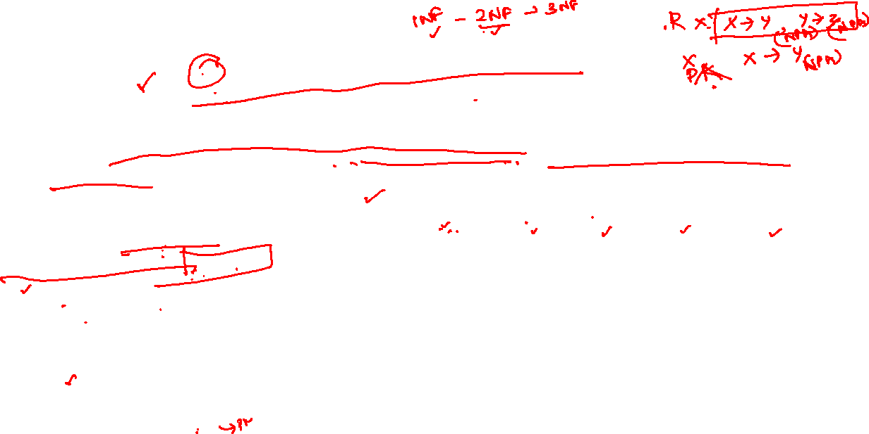
Normalization: 3 NF
A relation will be in 3NF
If it is in 2NF and not contain any transitive partial dependency.
3NF is used to reduce the data duplication. It is also used to achieve the data integrity.
If there is no transitive dependency for non-prime attributes, then the relation must be in third normal form.
A relation is in third normal form if it holds at-least one of the following conditions for every non-trivial function dependency X → Y.
X is a super key.
Y is a prime attribute, i.e., each element of Y is part of some candidate key.
EMPLOYEE_DETAIL table:
EMP_ID | EMP_NAME | EMP_ZIP | EMP_STATE | EMP_CITY
222 | Harry | 201010 | UP | Noida
333 | Stephan | 02228 | US | Boston
444 | Lan | 60007 | US | Chicago
555 | Katharine | 06389 | UK | Norwich
666 | John | 462007 | MP | Bhopal
Super key in the table above:
{EMP_ID}, {EMP_ID, EMP_NAME}, {EMP_ID, EMP_NAME, EMP_ZIP}....so on
Candidate key: {EMP_ID}

Slide 37
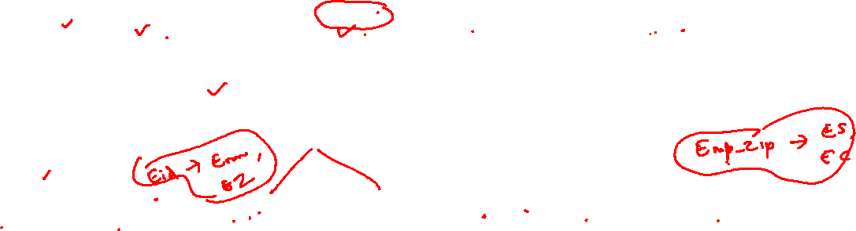
Normalization: 3 NF
Non-prime attributes:
In the given table, all attributes except EMP_ID are non-prime.
Here, EMP_STATE & EMP_CITY dependent on EMP_ZIP and EMP_ZIP dependent on EMP_ID.
Is table in 3NF?
The non-prime attributes (EMP_STATE, EMP_CITY) transitively dependent on super key(EMP_ID).
It violates the rule of third normal form.
SOLUTION ?
That's why we need to move the EMP_CITY and EMP_STATE to the new <EMPLOYEE_ZIP> table, with EMP_ZIP as a Primary key.
EMPLOYEE_ZIP table:
EMPLOYEE table:
EMP_ZIP | EMP_STATE | EMP_CITY
201010 | UP | Noida
02228 | US | Boston
60007 | US | Chicago
06389 | UK | Norwich
462007 | MP | Bhopal
EMP_ID | EMP_NAME | EMP_ZIP
222 | Harry | 201010
333 | Stephan | 02228
444 | Lan | 60007
555 | Katharine | 06389
666 | John | 462007

Slide 38



Normalization: 3 NF
3NF (no transitive dependency)
Check if table in 2NF already (ie., NPA are fully functional dependent on PA)
YES : Check if table in 3NF (ie., no transitive dependency)
Test : Relation should not have a nonkey attribute functionally determined by another nonkey attribute (or by a set of nonkey attributes). That is, there should be no transitive dependency of a nonkey attribute on the primary key.
Or
A relation schema R is in 3NF if every nonprime attribute of R meets both of the following conditions:
■ It is fully functionally dependent on every key of R.
■ It is nontransitively dependent on every key of R.
Remedy: Decompose and set up a relation that includes the nonkey attribute(s) that functionally determine(s) other nonkey attribute(s).
OR
we can say: A relation schema R is in 3NF if, whenever a non trivial functional dependency
SSN -→ Dnumber and Dnumber -→ Dname, DmgrSSN

Slide 39



3NF example

Slide 40

Boyce Codd NF
or
BC NF

Slide 41

BCNF ( BOYCE CODD NF)
BCNF is the advance version of 3NF. It is stricter than 3NF.
A table is in BCNF if every functional dependency X → Y, X is the super key of the table.
For BCNF, the table should be in 3NF, and for every non trivial FD, LHS is super key.
Example: Let's assume there is a company where employees work in more than one department.
EMPLOYEE table:
Candidate key:
{EMP_ID,, EMP_DEPT}
EMP_ID | EMP_COUNTRY | EMP_DEPT | DEPT_TYPE | DEPT_NO_OF_EMP
264 | India | Designing | D394 | 283
264 | India | Testing | D394 | 300
364 | UK | Stores | D283 | 232
364 | UK | Developing | D283 | 549
Is the table in BCNF?
The table is not in BCNF because neither EMP_DEPT nor EMP_ID alone are keys.
Super keys: {Emp_Id}, {Emp_Id, Emp_Country}, {Emp_Id, Emp_Dept}, {Emp_Dept}, {Emp_Id,Emp_Dept_no}…so on
In the above table Functional dependencies are as follows:
EMP_ID → EMP_COUNTRY
EMP_DEPT → {DEPT_TYPE, DEPT_NO_OF_EMP}
To convert it to BCNF:
The table is decomposed so that each FD here is
valid and every FD depends on SK on LHS

Slide 42

BCNF ( BOYCE CODD NF)
To convert the given table into BCNF, we decompose it into three tables:
EMP_COUNTRY table:
Functional dependencies:
EMP_ID | EMP_COUNTRY
264 | India
264 | India
EMP_ID → EMP_COUNTRY
EMP_DEPT → {DEPT_TYPE, DEPT_NO_OF_EMP}
EMP_DEPT_MAPPING table:
EMP_ID | EMP_DEPT
D394 | Designing
D394 | Testing
D283 | Stores
D283 | Developing
EMP_DEPT table:
EMP_DEPT | DEPT_TYPE | DEPT_NO_OF_EMP
Designing | D394 | 283
Testing | D394 | 300
Stores | D283 | 232
Developing | D283 | 549
Candidate keys:
For the first table: EMP_ID For the second table: EMP_DEPT For the third table: {EMP_ID, EMP_DEPT}
Now, this is in BCNF because left side part of both the functional dependencies is a key.

Slide 43


BCNF ( BOYCE CODD NF)
Example: Consider a relation schema
BOOK_RATING(ISBN, Book_title, R_ID, Rating) .
Two Candidate keys = {(ISBN, R_ID), (Book_title, R_ID)}.
Remedy : problem can be resolved by decomposing this relation schema into two relation schemas as shown here.
BOOK_TITLE_INFO(ISBN, Book_title) and
REVIEW(R_ID, ISBN, Rating)
Or
BOOK_TITLE_INFO(ISBN, Book_title) and
REVIEW(R_ID, Book_title, Rating)
Now, all these relation schemas are in BCNF. Note that BCNF is the most desirable normal form as it ensures the elimination of all redundancy that can be detected using functional dependencies.
Note:
If there is only one determinant upon which other attributes depend and it is a candidate key, 3NF and BCNF are identical.
This relation schema is not in BCNF since both the candidate keys are composite as well as overlapping.
However, it is in 3NF.

Slide 44



BCNF ( BOYCE CODD NF)

Slide 45





BCNF ( BOYCE CODD NF)
Normalize the relation professor so as it is in BCNF.
The PROFESSOR Relation decompose into two relation:
PROF 1 and PROF 2 respectively.

Slide 46


BCNF ( BOYCE CODD NF)
Note: Every relation in BCNF is also in 3NF, but a relation is 3NF is not necessarily in BCNF
A relation is not in BCNF if
the candidate keys in the relation are composite keys (that is, they are not single attribute keys)
there is more than one candidate key in the relation
the keys overlap, that is, some attributes in the keys are common.

Slide 47



BCNF ( BOYCE CODD NF)
Note: Every relation in BCNF is also in 3NF, but a relation is 3NF is not necessarily in BCNF
Ex: Where each student may have only one tutor, but each tutor may have many students.
This table is subject to insertion anomalies as both the Tutor ID and SIN must be entered whenever a tutor-student pair is entered.
So decompose to convert to BCNF.
Candidate keys are: {ID, TutorID} and {ID, TutorSIN}
TutorID → TutorSIN and TutorSIN → TutorID, but because both TutorID and TutorSIN are prime attributes these FDs do not violate 3NF.
Neither TutorID nor TutorSIN alone are superkeys, and thus BCNF is violated.

Slide 48
4 NF

Slide 49


Normalization : 4NF ( MVD )
Multivalued dependency occurs when two attributes in a table are independent of each other but, both depend on a third attribute.
A multivalued dependency consists of at least two attributes that are dependent on a third attribute that's why it always requires at least three attributes.
Example: Suppose there is a bike manufacturer company which produces two colors(white and black) of each model every year.
Here columns COLOR and MANUF_YEAR are dependent on BIKE_MODEL and independent of each other.
In this case, these two columns can be called as multivalued dependent on BIKE_MODEL. The representation of these dependencies is shown below:
BIKE_MODEL | MANUF_YEAR | COLOR
M2011 | 2008 | White
M2001 | 2008 | Black
M3001 | 2013 | White
M3001 | 2013 | Black
M4006 | 2017 | White
M4006 | 2017 | Black
BIKE_MODEL MANUF_YEAR
BIKE_MODEL COLOR
This can be read as "BIKE_MODEL multidetermined MANUF_YEAR" and "BIKE_MODEL multidetermined COLOR".

Slide 50

Normalization : 4NF
A relation will be in 4NF
if it is in Boyce Codd normal form and has no multi-valued dependency.
For a dependency A → B, if for a single value of A, multiple values of B exists, then the relation will be a multi-valued dependency.
Example
STUDENT
Is the table in 4NF?
The given STUDENT table is in 3NF, but the COURSE and HOBBY are two independent entity. Hence, there is no relationship between COURSE and HOBBY.
In the STUDENT relation, a student with STU_ID, 21 contains two courses, Computer and Math and two hobbies, Dancing and Singing. So there is a Multi-valued dependency on STU_ID, which leads to unnecessary repetition of data.
STU_ID | COURSE | HOBBY
21 | Computer | Dancing
21 | Math | Singing
34 | Chemistry | Dancing
74 | Biology | Cricket
59 | Physics | Hockey

Slide 51
Normalization : 4NF
So to make the above table into 4NF, we can decompose it into two tables:
STUDENT_COURSE
STUDENT_HOBBY
STU_ID | COURSE
21 | Computer
21 | Math
34 | Chemistry
74 | Biology
59 | Physics
STU_ID | HOBBY
21 | Dancing
21 | Singing
34 | Dancing
74 | Cricket
59 | Hockey

Slide 52

BCNF to 4NF:
An entity type is in 4NF if it is BCNF and there are non multivalued dependencies between its attribute types.
Any entity is BCNF is transformed into 4NF :
(i) Direct any multivalued dependencies.
(ii) Decompose entity type.

Slide 53



Normalization : 4NF

Slide 54






Normalization : 4NF

Slide 55
5 NF

Slide 56

5NF
A relation is in 5NF
if it is in 4NF and not contains any join dependency and joining should be lossless.
5NF is satisfied when all the tables are broken into as many tables as possible in order to avoid redundancy.
5NF is also known as Project-join normal form (PJ/NF).
Is the table in 5NF?
SUBJECT | LECTURER | SEMESTER
Computer | Anshika | Semester 1
Computer | John | Semester 1
Math | John | Semester 1
Math | Akash | Semester 2
Chemistry | Praveen | Semester 1
NO its not!
In the above table, John takes both Computer and Math class for Semester 1 but he doesn't take Math class for Semester 2.
In this case, combination of all these fields required to identify a valid data.
Suppose we add a new Semester as Semester 3 but do not know about the subject and who will be taking that subject so we leave Lecturer and Subject as NULL. But all three columns together acts as a primary key, so we can't leave other two columns blank.

Slide 57



5NF
So to make the above table into 5NF, we can decompose it into three relations P1, P2 & P3:
P1
SEMESTER | SUBJECT
Semester 1 | Computer
Semester 1 | Math
Semester 1 | Chemistry
Semester 2 | Math
P2
SUBJECT | LECTURER
Computer | Anshika
Computer | John
Math | John
Math | Akash
Chemistry | Praveen
P3
SEMSTER | LECTURER
Semester 1 | Anshika
Semester 1 | John
Semester 1 | John
Semester 2 | Akash
Semester 1 | Praveen

Slide 58



Normalization: 5NF
A table is said to be in the 5NF if and only if it is in 4NF and every Join dependency in it is implied by the candidate key.

Slide 59

Lossless Decomposition or NonAdditive JD
A decomposition {R1, R2,…, Rn} of a relation R is called a lossless decomposition for R if the natural join of R1, R2,…, Rn produces exactly the relation R.
A decomposition is lossless if we can recover:
R(A, B, C)
Decompose
R1(A, B) R2(A, C)
Recover
R’(A, B, C)
Thus, R’ = R

Slide 60

Lossy and Lossless decomposition Problems:
1. R(A,B,C) ➔ R1(A,B) and R2(B,C)
Find if lossless or lossy decomposition or JD
R=
2. R(A,B,C) ➔ R1(A,C) and R2(B,C)
Find if lossless or lossy decomposition or JD
R=
A | B | C
1 | 2 | 1
2 | 5 | 3
3 | 3 | 3
A | B | C
1 | 2 | 1
2 | 5 | 3
3 | 3 | 3

Slide 61
Example :
Explain Is it Lossy or lossless join decomposition in the following relation
R(A, B,C,D,E) and F={ A->B, B->C, D->C, D->E} Where R is decomposed
into R1(A,B,D) and R2(C,D,E) ?

Slide 62

Example :
Explain Is it Lossy or lossless join decomposition in the following relation
R(A, B,C,D,E) and F={ A->B, B->C, D->C, D->E} Where R is decomposed
into R1(A,B,D) and R2(C,D,E) ?
Solution:
A B C D E
A B C D E
Therefore LOSSLESS JD.
R1
D | D | D | D | D
 |  | D | D | D
R2

Slide 63

Example
Given:
Lending-schema = (branch-name, branch-city, assets, customer-name, loan-number, amount)
Required FD’s:
branch-name→branch-city assets
loan-number→amount branch-name
Decompose Lending-schema into two schemas:
Branch-schema = (branch-name, branch-city, assets)
Loan-info-schema = (branch-name, customer-name, loan-number, amount)
Show that decomposition is Lossless Decomposition

Slide 64



Problems:
2. R = (A, B, C, D, E). We decompose it into R1 = (A, B, C),
R2 = (A, D, E). The set of functional dependencies is: A → BC, CD → E, B → D, E → A. Show that this decomposition is a lossless-join decomposition.
1. R(A,B,C,D,E) and F={A->D,B->C, AB->E} Is it in 1NF, 2NF, 3NF or BCNF?

Slide 65

Problems:
3. R(A,B,C) and F={A->B, B->C} is in 3NF or not?
4. R(A,B,C,D) and F={A->BCD, BC->D, D->B} is it in BCNF or not?

Slide 66


NF
Remedy : problem can be resolved by decomposing this relation schema into two relation schemas as shown here.
BOOK_TITLE_INFO(ISBN, Book_title) and
REVIEW(R_ID, ISBN, Rating)
Or
BOOK_TITLE_INFO(ISBN, Book_title) and
REVIEW(R_ID, Book_title, Rating)
Now, all these relation schemas are in BCNF. Note that BCNF is the most desirable normal form as it ensures the elimination of all redundancy that can be detected using functional dependencies.
Note:
If there is only one determinant upon which other attributes depend and it is a candidate key, 3NF and BCNF are identical.
BOOK_RATING(ISBN, Book_title, R_ID, Rating) .
Two Candidate keys = {(ISBN, R_ID), (Book_title, R_ID)}.
This relation schema is not in BCNF since both the candidate keys are composite as well as overlapping.
However, it is in 3NF.
Relation in BCNF

Slide 67


NFs Overview
Functional dependencies (FD): tool to detect redundancies in schemas
Relations can be in different normal forms - the higher, the less redundancies. But there is a trade-off (see above).
If a relation is in BCNF, it is free of redundancies that can be detected using FDs. Thus, trying to decompose into BCNF is a good heuristic.
If a relation is not in BCNF, we can try to decompose it into a collection of BCNF relations.
Decompositions can be loss-less and/or dependency-preserving
Must consider whether all FDs are preserved.
If a dependency-preserving decomposition into BCNF is not possible (or unsuitable, given typical queries), should consider decomposition into 3NF.

Slide 68

THANKS

